Slide 1
Please don’t lose it!
Children who have experienced trauma
Julz Kelly (Registered Psychologist) Terra Firma Psychology

Slide 2
What group of children are we talking about?
Exposure to any of the following:
    Neglect
    Abuse
    Violence
    Problematic alcohol and drug use
Multiple home placements with family or foster carers
Behavioural, emotional and social difficulties across settings

Slide 3
From the start…
Mainstream knowledge that the first three years of life are important
Experiences during this time ‘shape’ the developing brain - bidirectional
Repeated experiences create pathways in the brain
Less frequently used pathways get ‘pruned’

Slide 4
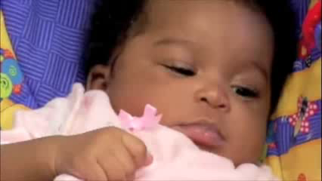
Edward Tronick - The Still Face experiment

Slide 5
Attachment
Attachment
  Concept of emotional regulation - secure base
  Comfort versus discomfort/fear/uncertainty

Slide 6
Stress
  Activation of attachment – proximity seeking – ‘I want my mum’
Positive
  Short lived
  Supported
Tolerable
  Emotional support from 1+ adult(s)
  Shorter duration
Toxic
  Ongoing
  Adult preoccupation

Slide 7
What might you see?
Triggers – patterns
Someone else’s car – tractor – tyres – ‘unpredictability’

Slide 8
What you might see
‘Unpredictable’ outbursts
Withdrawn/emotionally “flat”
Uninhibited behaviour
Task avoidance
No apparent understanding or fear of consequences
‘Odd/bizarre’ behaviour
Poor relationships with others
Learning delays, inconsistent academic performance

Slide 9
You might hear the following statements made about them:
“It’s a choice – I know he can control his behaviour but it was deliberate”
“He’s just naughty”
“It’s like she wants to ruin it for everyone else in the class”
“He actually doesn’t care – never feels bad for anything he’s done”
“Whenever he’s good it’s because he wants something”

Slide 10
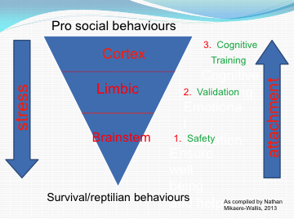

Slide 11
As adults
Be (appear) calm and confident - pilot
Don’t expect gratitude – one rough ride
Don’t be a buddy – ‘stranger danger’ , personal disclosure
Avoid projecting – ‘challenge authority’
Impose a consequence – don’t be one
Self care
Hold in there

Slide 12
Things to consider
Avoid giving the behaviour power – superpowers, lack of safety
Keep it tight – realistically – no animals inside
Practice compliance – primed refusal
Give limited choices

Slide 13
Things to consider (2)
Ascertain the child’s emotional ‘age’ – I ‘know’ but …
  Body versus mind
  Abstract versus concrete
  Tailor responses
Emotion
  Label
  Model
  Too much to handle – dissociation - remorse
Prepare other children
Prepare parents

Slide 14
Practicing acting out – upset the pattern versus ‘consistency’
Teacher gives direction
X doesn’t follow
Teacher gives direction
X yells ‘no’
Teacher ‘tells off’ X
X starts yelling and swearing

Slide 15
Acknowledgements
Tronick Edward. The Still Face Experiement. https://www.youtube.com/watch?v=Btg9PiT0sZg
http://www.brainwave.org.nz/wp-content/uploads/2014/09/Stress-TGBU_2.pdf
http://www.brainwave.org.nz/wiring-the-brain-2/
Children With Trauma (Ruth Humphries, Sarah Whitcombe-Dodds)
X’s Behaviour plan (Julz Kelly, Ruth Humphries, Di Havler)

